Slide 1
Molina Healthcare Update
Presented by: Jorge Rivera, Director,
Community Engagement

Slide 2
What we will cover
About Molina
What is happening in WA Medicaid…
Molina in Apple Health
Molina in Dual Snip Medicare
Contact Information

Slide 3
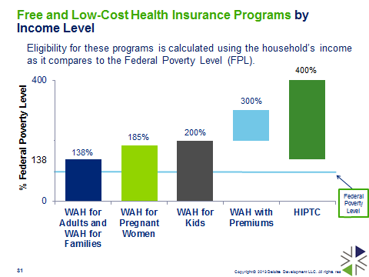
Who do we help?...
Molina Healthcare Focus
Limited profit contracts
This is the population we understand and have served in WA
for 20 years, we feel proud to be able to help

Slide 4
Molina in Washington State
Largest “Apple Health” plan in the state, 44% of Washington’s 1.5M members served
Chosen by about a half (49.2%)
of all new members joining Medicaid
Longest standing “Commendable” Quality Accreditation from NCQA
Longest standing “Multicultural Healthcare” Distinction from NCQA
Largest Medicaid provider network including 101 of all 102 state hospitals, and more than 25,000 providers of primary and specialty care in all 39 counties
NCQA = National Committee for Quality Assurance

Slide 5
The Path towards IMC – Integrated Managed Care
What is changing in Washington State Medicaid?
In 2014 the state of Washington legislature decided to start integrating Medicaid services for physical health, behavioral health, and substance use disorder treatment under the service of Managed Care Organizations
In April of 2016 the first region, SW WA, Early Adopter went live with over 80,000 members
In 2017 the second region, NC WA, decided to move forward with IMC, went live this year with over 70,000 members
This year the state completed scoring and assignments for selected MCOs in all remaining regions

Slide 6
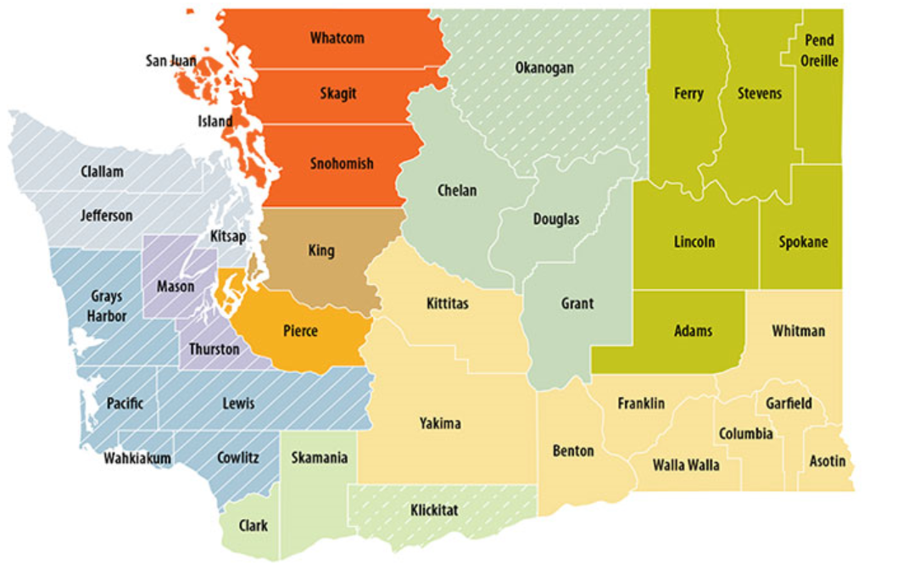
State Scoring of MCOs for Integrated Managed Care
2019
2020
2019
2018
2019
2020
2019
2020
2019
2016
2014
Molina Awarded 1st Place in each of 10 regions of the state, including Pierce County

Slide 7
Integrated Financing = Integrated Care

Slide 8
Integrated Managed Care What Does Better Look Like?
Better medical care and outcomes for people living with chronic mental illness
Better identification and treatment of behavioral health conditions in primary care
Better integration of fragmented systems through care coordination – no falling through cracks
Better inclusion of Social determinants of Health
Triple Aim
Better health outcomes
Lower total cost of care
Better Patient/ Provider experience

Slide 9
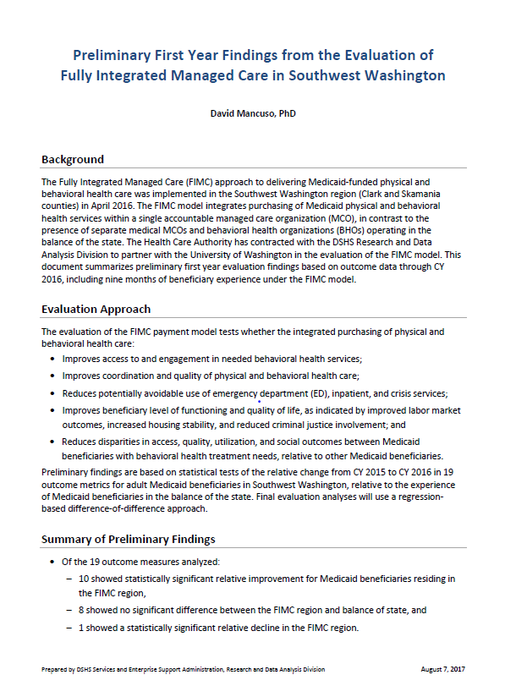
Leader in Integrated Managed Care
Molina was one of the two MCOs selected for the first implementation, Early Adopter, of IMC in 2016
We are currently serving more than 130,000 members already converted to IMC, more than 80,000 of them for over 2 years
Molina has signed agreements with all current providers of Behavioral Health and Substance Use Disorder treatment, previously contracted with the local BHO, in all current and upcoming regions
The first official report from DSHS about health outcomes under Integrated Managed Care after the first year, showed overall improvement compared to regions not yet on IMC
Of 19 metrics in the study 10 showed greater relative improvement, 8 stayed even and only 1 showed lower relative improvement than non IMC regions

Slide 10
Regional Membership
Molina also has the highest percentage of new member choice in Pierce County with 48% of new enrollments when member makes the choice
Choice represents 40% of all new enrollments in Washington State; Re-enrollments (28%), Family Connections, (18%), and Government Assignments (14%) make up the rest, Molina is highest in all enrollment categories
Source: WA State Healthcare Authority July 2018

Slide 11
Benefits and Incentives for Medicaid

Slide 12
Virtual Urgent Care
Member can talk or video chat with a provider 24/7 from their phone, tablet or computer. No appointment needed. Virtual care doctors and nurse practitioners can treat minor conditions like:
Colds
Rashes
Ear pain
Pink eye
and more!
Once member has been assisted via virtual visit, the member’s Primary Care Provider assigned receives a full report from the urgent care provider, to ensure continued care and allow for the member’s family clinic follow up.
More than 3,000 Molina members have already and successfully used virtual urgent care services.
“Very informative and personable, making the experience wonderful! I felt very comfortable, especially knowing what I can do to care for myself afterwards.”
Molina Member

Slide 13
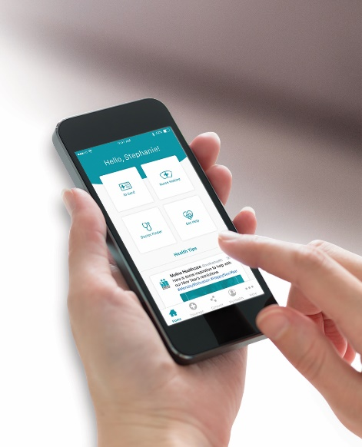
My Health in Hand & My Molina
Free Cell Phone for Members
Molina’s supports Safe Link Wireless Free Cell Phone service for its members, they can easily be connected to a free cell phone with 350 monthly minutes to access services and 1Gb Data to download.
We are also connecting our systems so that calls to Molina Member
Services line will not count towards members monthly minutes.
Molina’s phone app and smart phone enabled information for members provides them with access and help to:
Find a doctor or clinic near you
Connect to our Virtual Urgent Care Clinic
See member’s ID card
Change your Primary Care provider
Make payments (QHP)
See health information anytime
See you service history
And more!

Slide 14
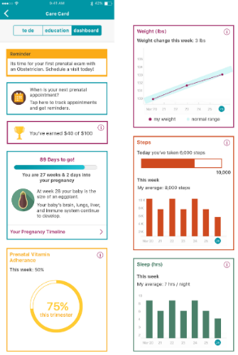
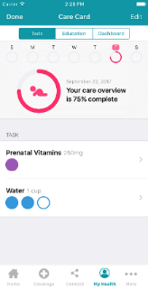
Healthinhand App - New Features*
Push notifications
Prenatal program
Lab results added to MyHealth
Simplified registration
Marketplace paperless billing enrollment (effective 1/1/19)
* Coming this fall
Notes:
Push notifications – the ability to send messages to members through campaigns (live now, but need to funds to build campaign)
Pregnancy program – Live- already went in Ohio and now Florida
Lab results added to “My Health”
Simplified registration for MyMolina and HiH
Paperless billing: The project team has specified that for phase 1 of paperless billing, HealthInHand will only display the member’s current enrollment status. Users can enroll only on the desktop portal. For phase 2, members should be able to enroll through the HealthInHand app as well.
Future Possible Enhancements:
Admin impersonation mode – give users in the contact center the ability to impersonate a user for technical support
Appointment reminders – use push notification to remind users of upcoming appointments with their care manager
Push notification campaigns – send out messages to members to remind them to get flu shots or for redetermination (other ideas welcome)
Urgent care finder – one click urgent care finder locates the nearest urgent care and links to directions based on currently location
Incentive programs – use push notifications to distribute rewards for various incentive programs
Integrated care manager messaging with mCare

Slide 15
Health Incentives Health Programs
Up to $200 per member per year in health-related gifts they can choose online for using preventive and chronic care services such as:
• Well-child exams
• Immunizations for children
• Breast cancer screenings
• Care during pregnancy and after baby is born
• Cervical cancer screening
• Breast Cancer screening
• Diabetes management
Sports Physicals: Covered only if part of a full well-child visit, and according to age of the member; this way we ensure child is fully screened, which helps CHCs quality metrics goals, and not just completing a requisite for sports participation
Weight Watchers®
Available to qualifying members 18 years and older.
Motherhood Matters® Pregnancy Program
Learning how to have a healthy pregnancy and the services available.
Text4baby
Free text messages on baby care at text4baby.org
Stop Smoking Program
Kick the habit through one-on-one counseling and education.
Women’s Health
Get resources on ways to stay healthy like wellness exams, important screenings and maternity care.

Slide 16
Servicing LGBT Community in Washington
Some community partners have expressed struggle to understand MCO services provided under Medicaid that are specifically related to gender transition.
Molina covers, and is currently actively servicing with no need for prior authorization, the following services:
Hormonal Therapy
Psychosocial Therapy
In cases where the providers want to do extended psychological evaluation, those could require PA
Molina also actively supports community based organizations providing services with focus in LGBT Community such Oasis Youth Center and across the state.

Slide 17
Molina and the Social Determinants of Health
Molina partners with more that 1,200 Community Based Organizations across the state, more than 200 in Pierce County alone.
Many of these provide supportive Housing (140+) and Supportive employment (80+) services
We have also developed joint programs with Care Coordination Organizations for transitional housing, respite medical, and others
Molina participated in the creation of the Foundational Community Supports since 2014, and currently participates in the work related to this benefit
On the other hand, though, Molina support a larger set of initiatives for supportive housing, with different timelines and sustainability plans

Slide 18
Molina Support Dental Managed Care
Molina chose not to directly bid for a Medicaid dental managed care service, and instead selected Delta Dental (Dentegra), a national and local leader in managed care dental services, as strategic oral health partner; Molina will also work with other managed care providers selected
We believe this partnership will improve access to oral health and oral health outcomes for Molina members
The Molina-Delta Dental partnership supports many of HCA’s stated objectives for the Managed Care Dental program including:
Reduced emergency room visits for dental services and treatment of oral health conditions by facilitating increased access to consistent dental care
Improved oral health outcomes for Medicaid clients
Retention of innovative programs such as Access to Baby and Child Dentistry (ABCD) program and the Oral Health Connections Pilot Project that improve access and care and develop new programs that improve access to care and dental outcomes
Providing timely access to dental services and coordination of dental and physical health services, as clinically indicated through care management

Slide 19
Call Center Operations and Outreach
Another Benefit
Member Services
Live service in several languages
M-F 8am-5pm + Voice Mail
Service level over 80% and less than 3% Abandoned rate
New Enrollments
Eligibility Questions
Full application completion for Medicaid and QHP
Leads and referrals processing
Provider detailed search
Renewals
Calling 25,000 to 30,000 members a month
Live assistance in recertification for Medicaid, no Robo-calls
3 Calls per member, close to 10,000 assisted per month
Eligibility Phone Calls
800-294-8620
Marketplace Calls
855-540-1983

Slide 20
Molina and Medicare DNSP
Jim Maguire, Medicare Sales Manager

Slide 21
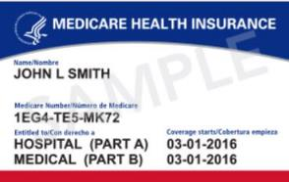
What is Medicare?
Medicare is the largest health insurance program offered by the U.S. government
Medicare is divided into Parts A, B, C and D. Parts A and B are known as “Original Medicare”
• Medicare covers Americans 65 and older or those who qualify due to disability

Slide 22
Medicare Parts A, B, C & D
Parts | Who Offers | What it is
Medicare Part A Hospital insurance | The Federal Government | Part A helps cover you when you are admitted to a hospital or skilled nursing facility. It also helps cover hospice care and home healthcare.
Medicare Part B Medical Insurance | The Federal Government | Part B helps cover your doctor’s visits and outpatient care. It also helps with services Part A doesn’t cover. Part B also covers some preventive care. You usually pay a monthly premium for Part B.
Medicare Part C Medicare Advantage | Health Insurance Companies | Part C helps cover everything in Parts A & B, they can also cover additional benefits not covered by Original Medicare, like wellness programs.
Medicare Part D | Insurance Companies and other private companies | Part D is optional prescription drug coverage for beneficiaries with Medicare.

Slide 23
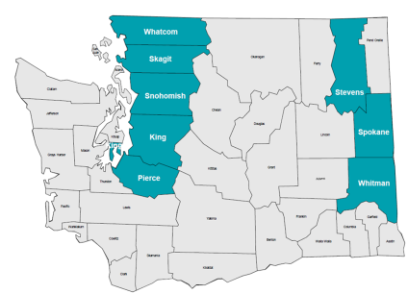
Are you eligible for a Medicare Advantage Plan?
Must permanently reside in the Medicare Advantage plan service area for Washington
Counties:
King
Pierce
Skagit
Snohomish
Spokane
Stevens
Whatcom
Whitman

Slide 24
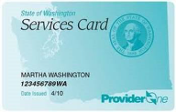
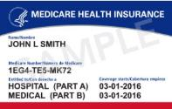
What is a Medicare Advantage Dual Special Needs Plan (D-SNP)?
Must be entitled and enrolled in Medicare Part A and Medicare Part B and Medicaid
Must live in the plan’s service area
Must not have End Stage Renal Disease (ESRD). ESRD is permanent kidney failure and requires regular kidney dialysis or a transplant to stay alive
Must use providers, pharmacy and services within the Plan Network
Must coordinate all care with specialists through the Primary Care Physician

Slide 25
Why Molina Healthcare? It’s simple, really…
Additional benefits above what is currently covered under Original Medicare
Access to providers!
Part A, B and D, all with one card
Additional Resources – Community Connectors, assigned case manager. All here to help you!

Slide 26
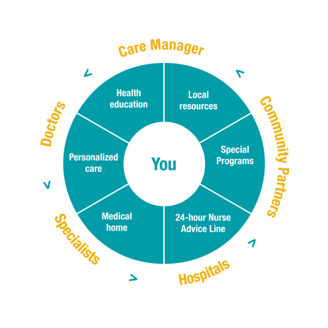
Model of Care

Slide 27
Questions?
If you would like to learn more about Medicare DSNP or would like a presentation for your agency, please contact:
Jim Maguire
Molina Medicare
Sales Manager-Washington
Phone: 253-441-9182
Email: james.maguire@molinahealthcare.com

Slide 28
In Summary
Molina is not only the largest Medicaid plan in the state, but also has the highest index of new member choice, and the longest standing “Commendable” quality accreditation and Multicultural Health distinction
Our focus are the most vulnerable, we are a Medicaid organization serving people who need government assistance for their health
We partner with the state on a contract limited to under 3% profit
Molina scored first place in each and everyone of the 10 regions for the Integrated Managed Care transition
Our benefits are focused in improving our people’s health, and in helping direct providers such as Community Health Centers engage more with members
Our regional engagement team has local presence across the state, we know and understand our communities; contact us if you need any assistance!

Slide 29
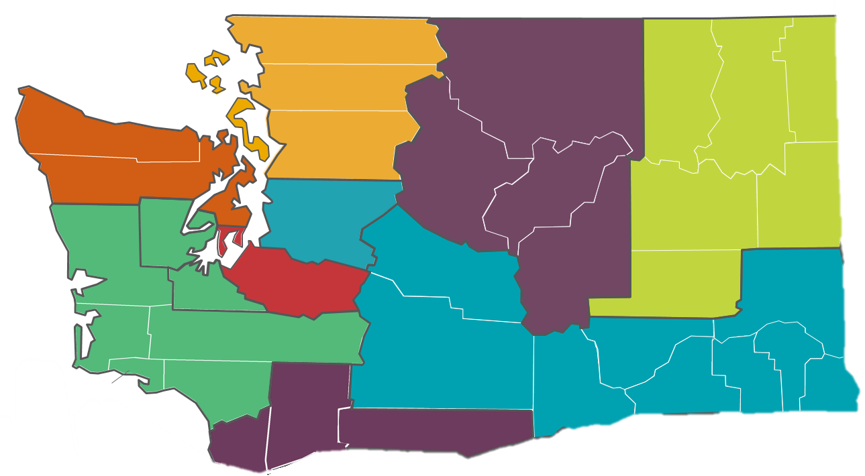
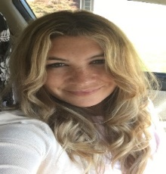
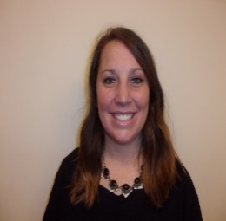
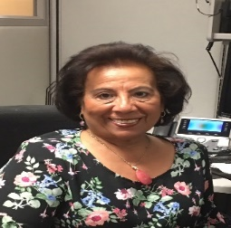
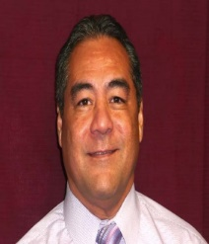
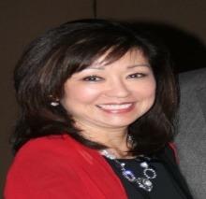
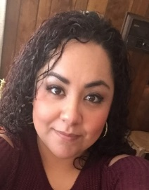
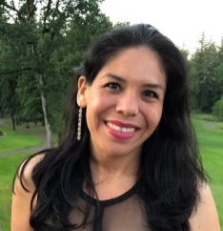
Molina’s Team Supports You!
Sonia Morales – King County
Sonia.Morales
@molinahealthcare.com
(425) 393-5501
Fluent in Spanish
Anastasia Garcia – North Sound
Anastasia.Garcia@molinahealthcare.com
(425) 773-2116
Fluent in Russian
Donny Guerrero – North Central WA
Donaciano.Guerrero@molinahealthcare.com
(509) 264-5725
Fluent in Spanish
Shannon Dayton – Better Health Together
Shannon.Dayton@molinahealthcare.com
(509) 951-9939
Carlos Mejia Rodriguez – Olympic Peninsula
Carlos.MejiaRodriguez@molinahealthcare.com
(360) 489-7969
Fluent in Spanish
Carlos Mejia Rodriguez – CPAA
Carlos.MejiaRodriguez@molinahealthcare.com
(360) 489-7969
Fluent in Spanish
Fenice Fregoso
Greater Columbia
Fenice.Fregoso@molinahealthcare.com
(509) 317-0910 | Fluent in Spanish
Carrie Ching – Pierce County
Carrie.Ching@molinahealthcare.com
(253) 973-5171
Fluent in American Sign Language
Aideet Pineda – Southwest WA
Aideet.Pineda@molinahealthcare.com
(360) 296-6481
Fluent in Spanish
Jeanne “JJ” McMinds – Statewide Tribal Relations
Jeanne.McMinds@molinahealthcare.com
(369) 485-9991
Office: 425-424-1100, Ext: 142931

Slide 30
Thanks!

