Slide 1
Wells Fargo At Work SM Paying for college basics
© 2019 Wells Fargo Bank, N.A. All rights reserved. Member FDIC.
For public use.

Slide 2
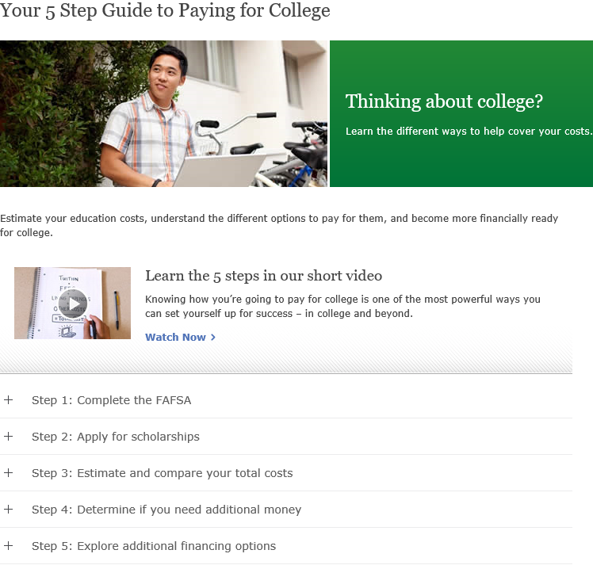
Your 5 Step Guide to Paying for College website
The website contains information about paying for college.
Step 1: Complete the Free Application for Federal Student Aid (FAFSA®).
Step 2: Apply for scholarships.
Step 3: Estimate and compare your total costs.
Step 4: Determine if you need additional money.
Step 5: Explore additional financing options.
wellsfargo.com/fivesteps

Slide 3
Step 1: Complete the FAFSA
Use the FAFSA form to apply for financial aid for college or graduate school.
Tips:
Access the form on the Federal Student Aid website, an office of the U.S. Department of Education.
Follow the instructions on the site.
Pay close attention to submission deadlines.
studentaid.ed.gov/fafsa

Slide 4
Step 2: Apply for scholarships
Visit the TFS Scholarships website for free access to scholarships.
Tips:
Research scholarships.
Apply for scholarships as early as your freshman year of high school.
Reference the site often throughout high school and college.
tuitionfundingsources.com

Slide 5
Step 3: Estimate and compare your total costs
Use the Net Price Calculator (NPC) tool at each college’s website to estimate costs.
Tips:
Enter the required data into the tool.
Review the estimated costs.
The estimate of one school’s calculator may differ from another’s because of the data requested.

Slide 6
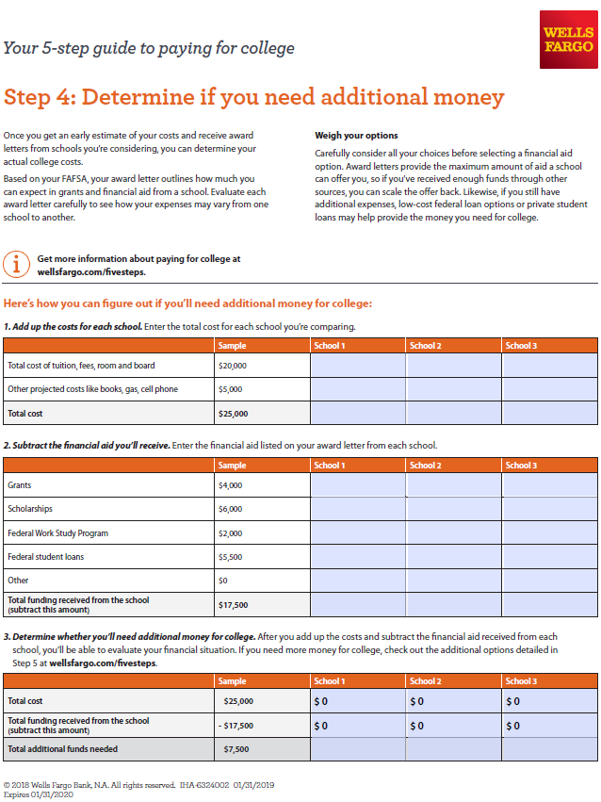
Step 4: Determine if you need additional money
Wells Fargo has a tool that may help you organize the information that you have gathered.
Tips:
Add up the costs for each school.
Subtract financial aid you could potentially receive.
Determine if you’ll need additional money.

Slide 7
Step 5: Explore additional financing options
Research all financing programs carefully by comparing:
Eligibility requirements
Interest rates
Total loan cost including fees
Repayment options
Monthly payments

Slide 8
Wells Fargo tools and resources
Call us or visit our websites for more information.
Phone: Our dedicated Student Loan Consultants will work with you to help you understand your options every step of the way. Call 1-800-378-5526, Monday through Friday, 7:00 a.m. – 8:00 p.m. Central Time. Online: wellsfargo.com/collegesteps Find tips and tools that may help you on your journey to and through college. wellsfargo.com/five-steps Estimate your education costs, understand your options, and find information to financially prepare for college.

Slide 9
9

