Slide 1
What you should know.
Wellness for Emergency Workers: volunteers, first responders, health workers.
Ivan Tudela​
Unified Command Briefing​
Elizabeth Allen​
eallen@tpchd.org​
Tacoma Pierce County Health Department

Slide 2

What is COVID-19?
COVID-19 is a new respiratory virus with no vaccine or treatment. Most people will recover on their own, but some people can develop pneumonia and require medical care or hospitalization. COVID-19 transmission is widespread in our region.
COVID-19 is not connected to race, ethnicity or nationality. Stigma will not help to fight the illness. Misinformation can spread faster than diseases. Do your part to prevent this. Seek—and share—accurate information.

Slide 3
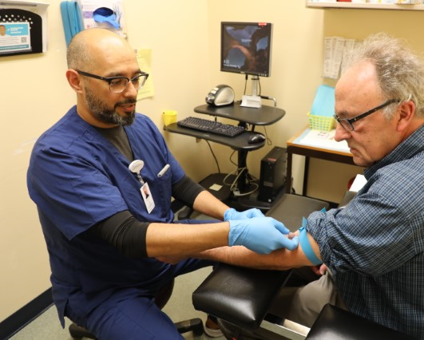
What are COVID-19 symptoms?
Symptoms of COVID-19 primarily include fever, cough, and shortness of breath. These symptoms appear 2 to 14 days after exposure.

Slide 4
Can a person spread the infection if they don’t feel sick?
People who are infected can spread COVID-19 before they show symptoms. Right now, researchers believe patients are most contagious when they are sickest.
The health department will evaluate any changes needed to our response.

Slide 5
How does COVID-19 spread?
COVID-19 can spread through the air when an infected person coughs, sneezes or talks near others, or through close personal contact like shaking hands.
You can also get it when you touch something that has the virus on it, then touch your mouth, nose or eyes before you wash your hands.
The virus can spread before people show symptoms.

Slide 6
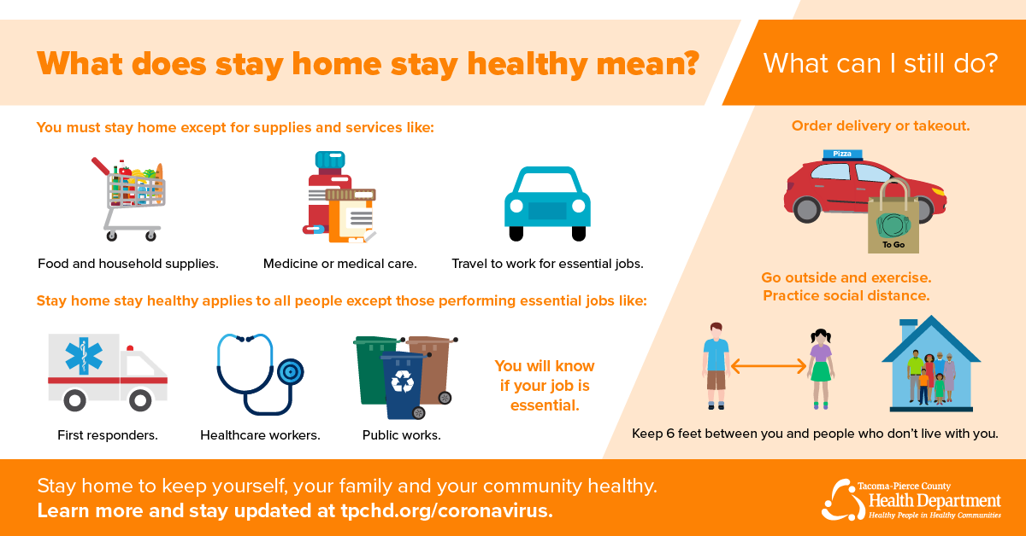
Notes:
At this time, the Governor has asked that residents of WA state stay home and limit public exposure.

Slide 7
Reliable information.
https://www.cdc.gov/coronavirus/2019-ncov/index.html
https://www.samhsa.gov/
https://www.tpchd.org/
https://www.doh.wa.gov/
Notes:
There is a lot of information on the web, social media and from friends. These links/websites are some good examples of reliable, updated information.

