Slide 2
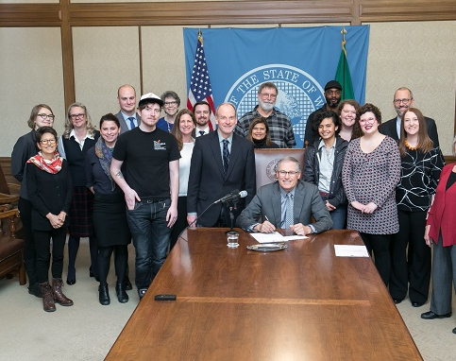
Youth aging out of Extended Foster Care during pandemic
Notes:
Approximately 20 young adults “age out” of extended foster care every month in WA ( ~ 250/year)
Since Stay Home order, advocates have called on Governor’s office to provide continuing support to these young people
Approximately $952,000 to provide six months of modest financial support and light touch case management
Fits within allowable uses of CARES funding

Slide 3
Issue Summary
Approximately 20 young adults “age out” every month
Advocates calling on Governor to make resources available to youth aging out during pandemic
Approximately $952,000
Up to 6 months of support (through Dec 2020)
Fits within allowable uses of CARES funding ($1.4 bn)
OFM has not approved so far

Slide 4
Extended Foster Care
Voluntary program for youth ages 18-21 (age out on 21st birthday)
Eligibility:
Be state dependent on 18th birthday AND:
Enrolled in high school/HSE
Enrolled/applying to a post-secondary academic or vocational program;
Participating in a program or activity designed to promote or remove barriers to employment,
Employed 80 hours or more a month; or
Unable to engage in any of the above activities due to a documented medical condition
Federal match through Title IV-E
Services include:
Placement – in a foster home (20%) or Supervised Independent Living Placement (80%)
Case management
Attorney is appointed
Connections to other relevant programs (e.g. Independent Living etc).
Notes:
816 Youth Enrolled, 30% (242) age 20

Slide 5
Native American/Alaska Native
Data source: Kids Count (WA youth population data)

Slide 6
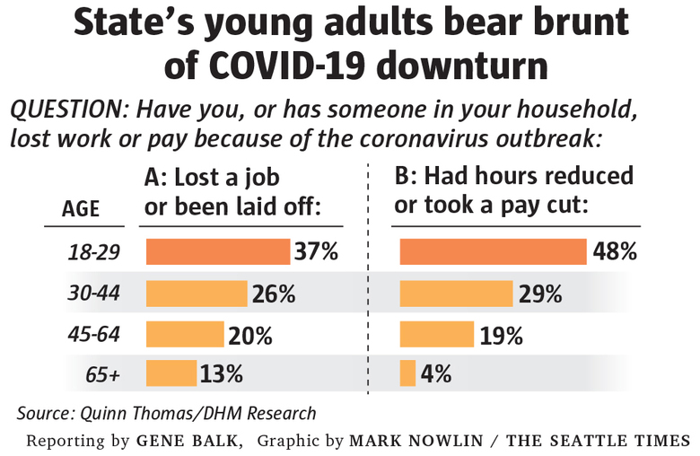
COVID-19 Impact
National survey of foster & former foster youth 18-23:
55% experiencing food insecurity
21% in financial crisis
72% have one month of expenses
48% lost job or reduced hours
Source: Field Center at Penn
Source: The Seattle Times, April 15, 2020

Slide 7
Other states?
Illinois, Alaska, Rhode Island, California, Georgia, Ohio – Governors’ moratorium on age out
Connecticut, South Carolina, Michigan – Administrative rule change

Slide 8
Take Action
Contact Governor Inslee & Office of Financial Management!
Key message: Approve emergency funding for youth aging out of foster care TODAY!
https://www.governor.wa.gov/contact/contact/send-gov-inslee-e-message
David.postman@gov.wa.gov – Chief of Staff
David.Schumacher@ofm.wa.gov – Head of OFM

Slide 9
Thank you!
Questions?
Liz Trautman
liz@mockingbirdsociety.org
(206) 406-6010

