Slide 1
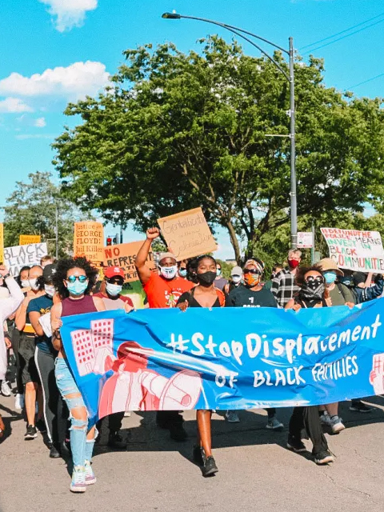
Community Benefits Agreement (CBA)
an economic empowerment mechanism by which stakeholder organizations can negotiate directly with developers for the benefits most important to them.
Notes:
https://i2.wp.com/chicagoreader.com/wp-content/uploads/2021/08/podcast_hannah_linksy.jpg?fit=1200%2C800&ssl=1

Slide 2
Communities Benefit from Agreements
Neighbor 2 Neighbor
Theresa Power-Drutis, New Connections, Tacoma
Notes:
tpdrutis@nctacoma.org

Slide 3
Our Neighborhood

Slide 4
One sized doesn’t fit all
What’s in the agreement? Who is involved in creating the agreement?

Slide 5
Nuts and Bolts
What we included
Who we included
As little as possible
Stated as clearly as possible
Goal: critical issues & shared interests
Avoid kitchen sink thinking!
As many as neighbors as possible
Invited as early as possible
Goal: broad engagement & transparency
But remember
Minimum # needed to make an agreement is 2

Slide 6
A Sample Agreement
Welcome to G Street. Creating a safe space for everyone in this neighborhood requires a commitment to certain agreements and expectations.
If you can’t adhere to these expectations please don’t stay.

Slide 7
For Physical Safety & Community Health
No acts of violence
No drug, sex, or human trafficking
Safely contain and dispose of:
Human and animal waste
Needles and other biohazards
If you want to cook, keep your fire/stove small, contained, and tended and be careful with propane.

Slide 8
For Community Wellbeing
Respect the privacy and property of neighbors, both housed and unhoused
Be mindful of noise levels, especially at night
Keep your area clean by putting trash in garbage cans. We welcome your participation in community clean ups!
If we see harm, the community will respond to address it. Please let someone know if you have questions or concerns, especially regarding your safety or the safety of others.
Your neighbors,
Signed by all neighbors who are in agreement

Slide 9
Reality Checks
Does everyone have to agree for CBAs to help?
How will you respond if agreements are not followed?
Do ALL agreements apply to housed neighbors too?
If not, why not?

Slide 10
