Slide 1


Intervention Costs
Gerrit Nyland
Social Services Supervisor
7/22/2022
Pg. 1

Slide 2
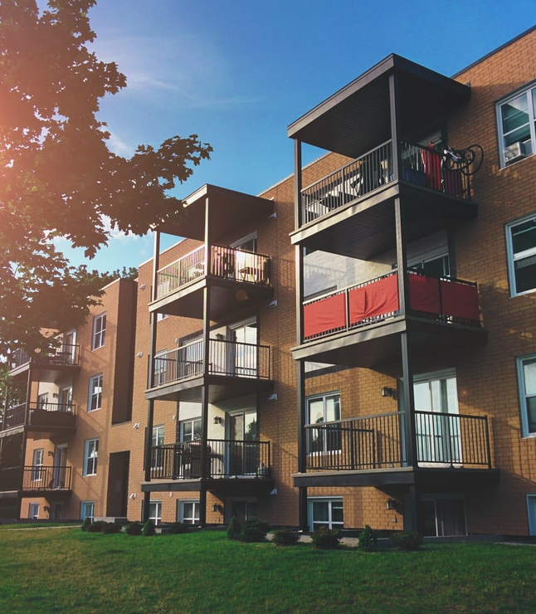
Why do Costs Matter
Understand Cost Benefit Ratio
Plan for unmet need
7/22/2022
Pg. 2

Slide 3

Dangers
Costs don’t tell the full story
7/22/2022
Pg. 3

Slide 4

Capital
Operations
Building, vehicles, most large one-time costs
Rent Assistance, salaries, overhead, furniture, transportation, lots of other stuff
7/22/2022
Pg. 4

Slide 5

Diversion
Capital | N/A
Rent Assistance | $750
Case Management | $650
Intervention Cost | $1,400
HEADER GOES HERE
www.website.com
Your Subheading Here
Sed a lacinia nulla, vitae imperdiet dui. Donec iaculis nulla eu metus viverra, eget lacinia risus lobortis. Praesent in nulla eu dolor maximus semper
7/22/2022
Pg. 5

Slide 6

Rapid Rehousing
Capital | N/A
Rent Assistance | $6,500
Case Management | $3,500
Intervention Cost | $10,000
7/22/2022
Pg. 6

Slide 7
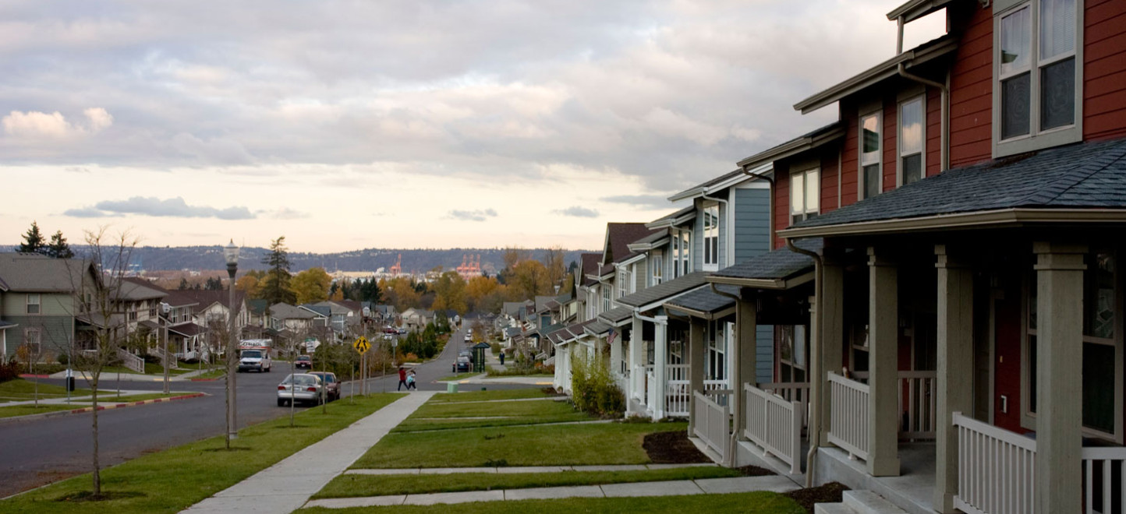
Capital | 0-$400k
Rent Assistance | $12k-24k
Case Management | $0
Annual Cost | $12k-24k
Housing Voucher
7/22/2022
Pg. 7

Slide 8

Capital | 0-$400k
Rent Assistance | $12k-24k
Case Management | $3k-$10k
Annual Cost | $15k-34k
Permanent Supportive Housing
7/22/2022
Pg. 8

Slide 9
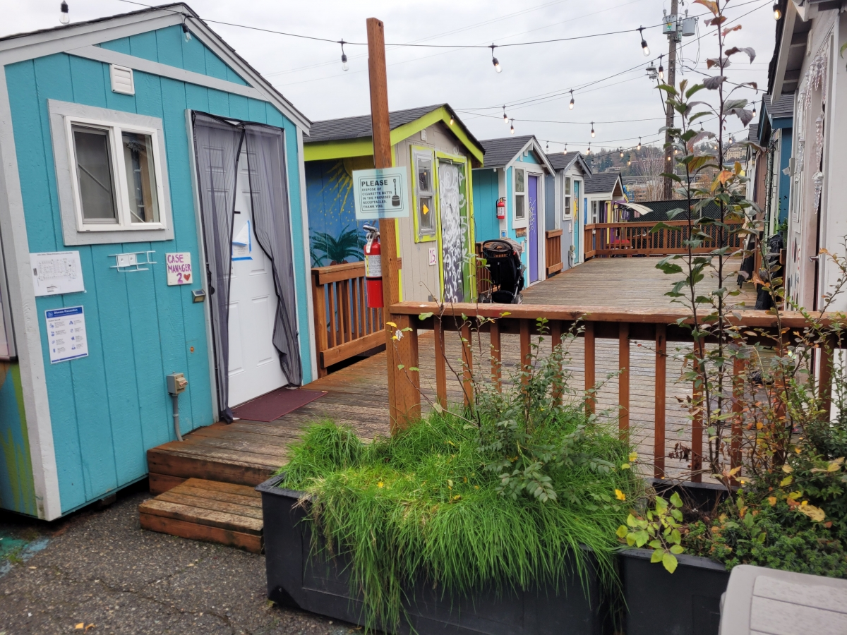
Shelter
Capital | $12k+
Rent Assistance | $0
Case Management | $12k-$25k
Annual Cost | $12k-$25k
7/22/2022
Pg. 9

Slide 10

Diversion | $1,500 | Intervention
Rapid Rehousing | $10,000 | Intervention
Housing Voucher | $15,000 | Annual
Permanent Supportive Housing | $22,000 | Annual
Shelter | $20,000 | Annual Bed
7/22/2022
Pg. 10

Slide 11
Annual Costs
7/22/2022
Pg. 11

Slide 12

Thank You
Questions?
7/22/2022
Pg. 12

