Slide 1
ALERT! Apple Health and the public health emergency
During the COVID-19 public health emergency (PHE), the Health Care Authority (HCA) extended coverage for all Apple Health (Medicaid) clients. This extension ends March 31, 2023
.
Notes:
Amerigroup is one of the five health plans under WA Apple Health.
We’ve been serving our members in WA since 2012 and commit to the whole person care to create value-added services designed to support people in improving their health and wellbeing.
To better serve our members we address social determinants of health like:
Homelessness/Housing
Employment
Education
Social Justice/Jail transition
Nutrition
Transportation

Slide 2
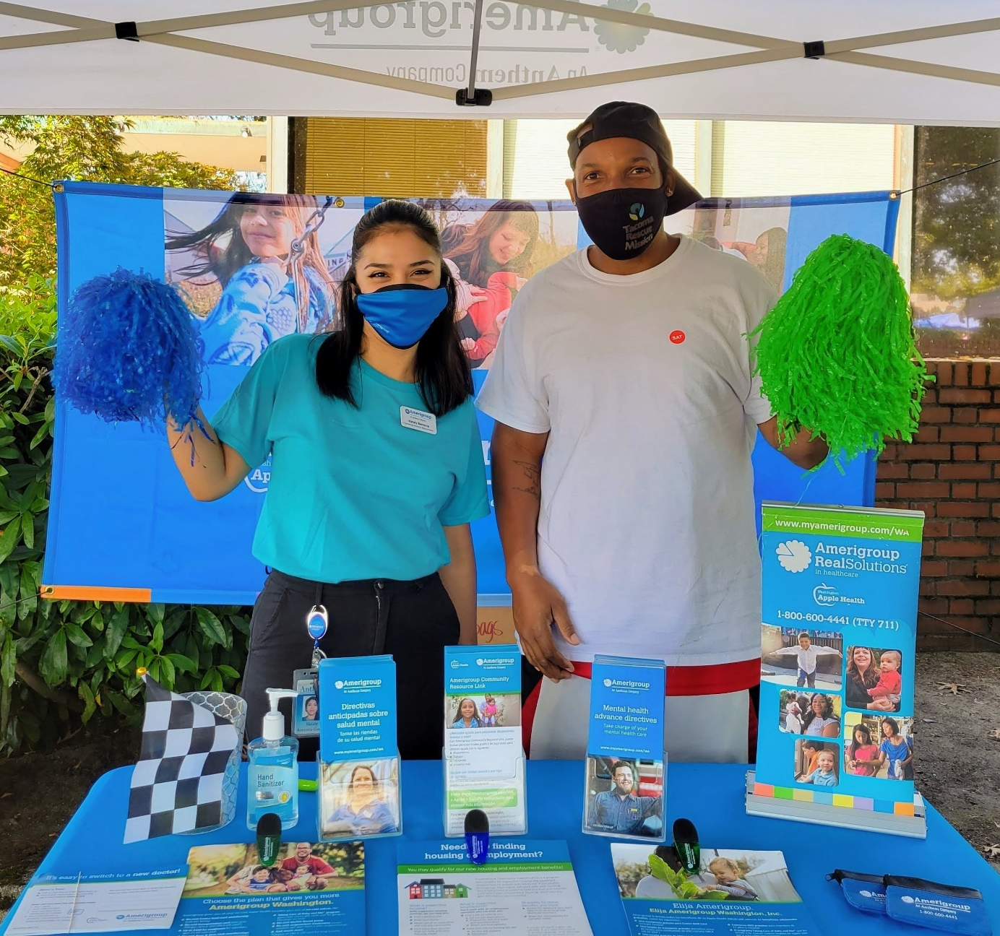
What does this mean for Apple Health Members?
HCA resumes normal operations April 1, 2023. Clients will receive a renewal notice prior to the end of their renewal period sometime over the next 12 months, based on a client’s renewal date.

Slide 3
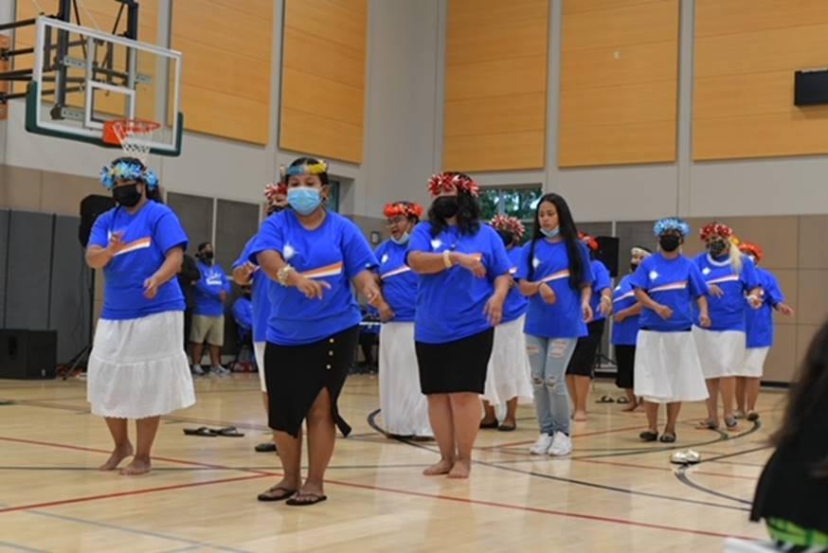
Are people losing their Apple Health coverage on April 1?
No. HCA anticipates resuming normal operations April 1, 2023. Members will receive a renewal notice prior to the end of their certification period sometime over the next 12 months, based on a Member’s renewal date. For example, members with a renewal date in May, will receive a renewal notice in the month of April.
Members found not eligible could lose their coverage as early as April 30th, but more likely at the end of May. Programs requiring the collection of premiums will resume at a future date following federal guidance.

Slide 4
How is Amerigroup reaching out to Members?
Outbound
50 days
30 days
15 days
5 days
Social/display ads
Video
Email
60 – 51 days
Auto Renewals
IVR
SMS
Mobile push/secure message
Mail
Inbound
NCC
Talking points for call reps, on-hold messaging
Website
Web touts on Recert pages pointing to Recert microsite
Member resources
Pop-up messages on Healthy Rewards and Aunt Bertha platforms

Slide 5
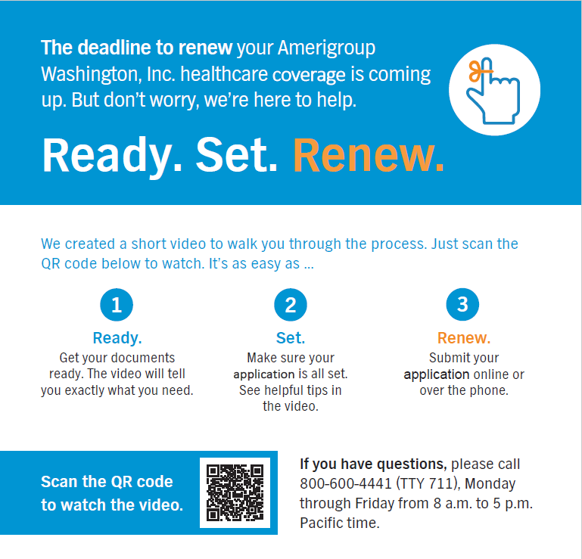
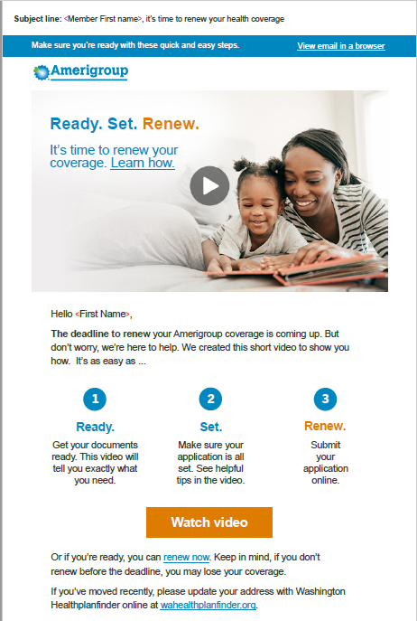
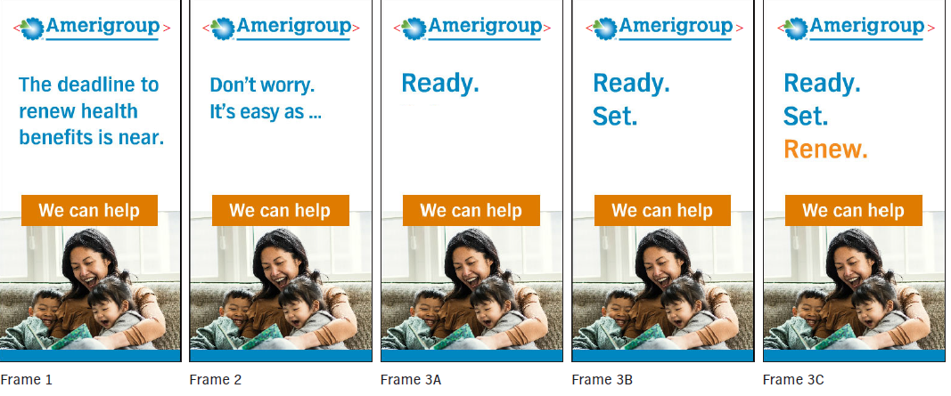
Examples of our message

Slide 6

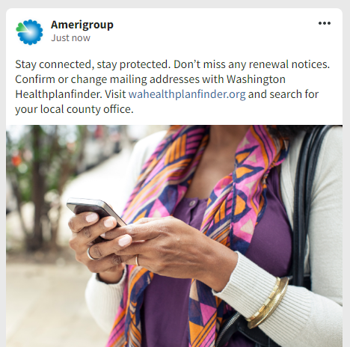
Social Media

Slide 7
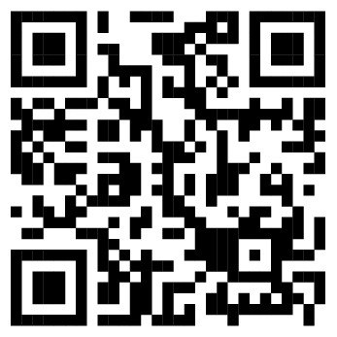
Ready. Set. Renew!

Slide 8
How can you renew coverage?
Use one of the following renewal options: Online at www.wahealthplanfinder.org
if you have a Washington Healthplanfinder account, log in and select “Update My Application and Renew Coverage” under Quick Links
If you don’t have a Healthplanfinder account, click “Apply Now”, enter your information and select “Update My Application and Renew Coverage” under Quick Links Using the WAPlanfinder mobile app
If you have a Healthplanfinder account or want to create one, use the WAPlanfinder app to renew coverage
The app is available on the App Store and Google Play Call Healthplanfinder Customer Support Center at 1-855-923-4633
Update the renewal document received via mail, sign and return using one of these options:
Mail: PO Box 946, Olympia, WA 98507
Fax: 1-855-867-4467 • CSO: Drop off at your local DSHS Community Service Office in the documents box in the lobby: www.dshs.wa.gov/office-locations

Slide 9
Anything else I should know?
If you have to report a change, report your changes today to be sure you get Apple Health (Medicaid) updates about your coverage. To learn more, download the HCA flyer on how to report a change in Washington Healthplanfinder.
Also available in the following languages:
አማርኛ - Amharic | العربية - Arabic | မြန်မာ - Burmese | អក្សរខ្មែរ - Cambodian (Khmer) | 中文 - Chinese | لفارسية - Farsi (Persian) | 한국어 - Korean | ພາສາລາວ - Laotian | ਪੰਜਾਬੀ ਦੇ - Punjabi | Русский - Russian | Af-soomaali - Somali | Español - Spanish | ትግርኛ - Tigrigna | Yкраїнський - Ukrainian | Tiếng Việt - Vietnamese

Slide 10

Member Services: 1-800-600-4441
TTY: 711
myamerigroup.com/wa | chooseamerigroup.com/wa

