Slide 1
City of Tacoma
Affordable Housing Action Strategy
Tacoma Area Coalition to End Homelessness
November 2, 2018
Notes:
Template Read-Me
Do not insert animations or slide transitions into your presentation.
Use only sans serif fonts (i.e.: Arial, Tahoma, Helvetica).
Fonts must be between 24 points and 32 points in size. The minimum point size allowed is 18.
Avoid having too much text.
If the text flows outside the safe title area, split the information into two or more slides.
Pictures with white backgrounds should be toned down by right clicking the mouse on the picture, then selecting Format Picture, lower the brightness by 10%.
Ensure graphics (pictures, charts) are high resolution so they can be easily viewed on screen.
The Safe Area grid lines that you see on the background should be removed when your presentation is completely formatted.
To remove the grid lines: Select the View tab. On the left side of the upper tool bar, click on Slide Master. Select the top most slide in the list. (You may need to scroll)
To select the Safe Area we suggest clicking on the upper left corner of the object. Once it highlights, press delete. Save your presentation.
Alternatively you may hide the Safe Area by clicking Hide Background Graphics in the Design tab for each slide in your presentation. (However, make sure this action does not also affect other graphics you have added to your presentation.)

Slide 2
PROJECT BACKGROUND
The City of Tacoma developed its Affordable Housing Action Strategy (AHAS) as an urgent response to its changing housing market, increasing risk of displacement among residents, and widespread need for high-quality, affordable housing opportunities for all.

Slide 3
DEVELOPMENT OF THE AHAS
AHAS project timeline
March
Task 1. Defining Tacoma’s key housing challenges
March-April
Task 2. Identifying and aligning actions
April-May
Task 3. Evaluating actions using evaluation tool
Task 4. Refining & prioritizing actions
Developing draft action strategy
August-Sept
Task 5. Delivering the Affordable Housing Action Strategy
May-July
Supported by stakeholder engagement, including with the Technical Advisory Group and informed by community engagement

Slide 4
OUTREACH FOR THE AHAS
The AHAS was developed through a range of outreach and engagement activities.
7
256
4
In-person community meetings
Online survey responses
Focus groups and interviews
7
7
8
Stakeholder interviews
Staff interviews
Technical Advisory Group meetings

Slide 5
EXPERIENCES FROM RESIDENTS
“Neither of my sons, one who works a minimum wage job and the other who is just starting a job, can afford to live on their own. So they live with me. They feel hopeless about their future ability to have a place of their own, to get married, and build a family.”
“What we are going through now is that I have two previous evictions and a low credit score. I’m shelling over $200-$300 for screening and application fees to just get denied.”
“I am on a fixed income and do not make two to three times the rental amount, so I cannot move from where I live now. I also don’t have money for a security deposit or the cost of moving. I live in a very small studio apartment, which costs me almost the entirety of my monthly SSI.”
“Most folks I know are one paycheck away from homelessness. If the building is bought out then a new owner can refuse to give us another lease. The only options for housing seems to be a terrible apartment like mine, where the heat and water go out during the winter but the tradeoff is that it is affordable.”

Slide 6
IMPRESSIONS FROM STAKEHOLDER INTERVIEWS
Tenant-landlord relationships A common theme across interviews was a need for stronger tenant-landlord relationships. Even though city services are available, language barriers or concerns about legal status may affect access.
Serving acute households These barriers include lack of income and credit, rental, or criminal histories, which may make it more difficult to access housing in the private market. One stakeholder noted the importance of having incentives for more private-market landlords to accept “high-barrier” people.
Important competencies among housing & other service providers These competencies included cultural competency for different ethnic groups and using trauma-informed approaches.
SOURCE: COMMUNITY ENGAGEMENT FOR THE AHAS THROUGH STAKEHOLDER INTERVIEWS.

Slide 7
DEVELOPMENT OF THE AHAS
The AHAS used a data-driven approach:
Housing needs assessment
Analysis of short-term and long-term market trends
Development and application of Housing Market Policy Dashboard

Slide 8
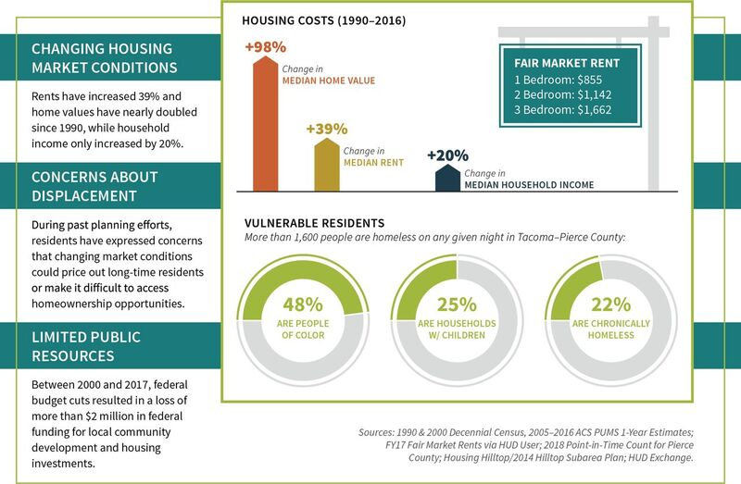
CURRENT CONDITIONS

Slide 9
SNAPSHOT OF HOUSING MARKET CONDITIONS & NEEDS
Accelerating housing market conditions Rent increased by 16% at single-family rentals & 17% at multifamily properties between March 2016 and March 2018.
Limited rental supply
Unmet need is greatest among extremely low-income households, followed by very low-income households.
Cost-burdens among households
Forty (40%) of households in Tacoma pay at least 30% of their income on housing costs each month.
%
%
Barriers accessing and staying in a home
Residents face a range of issues that affect their access to affordable housing units,
such as navigating multiple systems and language barriers.
SOURCES: ZILLOW, MARCH 2016-2018; 2016 AMERICAN COMMUNITY SURVEY 1-YEAR ESTIMATES; SOURCES: INTERVIEWS, FOCUS GROUPS, AND OTHER OUTREACH ACTIVITIES FOR THE AHAS (MARCH-MAY 2018).

Slide 10
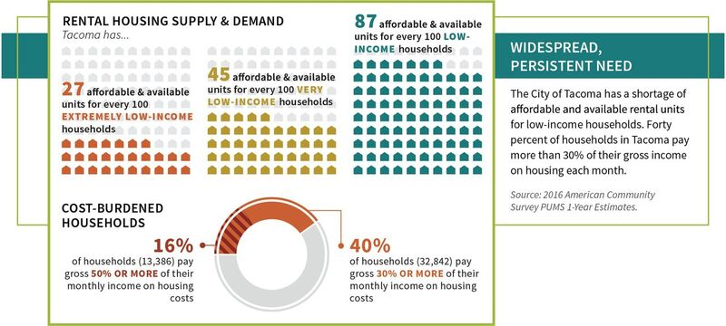
UNMET NEED FOR HOUSING

Slide 11
DASHBOARD OVERVIEW
Key assumptions:
Development will only occur where financially feasible.
Developers will build to maximum capacity.
Models multifamily development only.
Relationship to AHAS:
Informed proposed updates to inclusionary housing and the Multifamily Property Tax Exemption Program.
Enables ongoing monitoring and evaluation of market-based tools.
Visit the Housing Market Policy Dashboard at: http://tacoma.berk-maps.com/
Notes:
Focus of dashboard are proposed updates to the City’s Inclusionary Zoning and Multi-Family Property Tax Exemption programs
This tool is designed to see how to best harness the city’s growing market strength to produce new income-restricted units.
It allows the City and other external users to test the potential impact to affordable housing production of various regulatory changes (i.e. increases in allowable building heights, reduction in parking requirements, varying levels of affordability requirements) in addition to changes in market conditions and growth assumptions.
The tool will then determine expected outcomes in various parts of the city based on key assumptions

Slide 12
OVERVIEW OF THE AHAS
The AHAS includes:
Four strategic objectives and 24 supporting actions focused on:
Production of new homes (Strategic objective 1)
Preservation of existing homes (Strategic objective 2)
Anti-displacement and stabilization (Strategic objective 3)
Removal of barriers to housing (Strategic objective 4)
Implementation Plan
Metrics to monitor and report implementation over time:
Number of units produced
Number of units preserved
Number of households served

Slide 13
OVERVIEW OF THE AHAS
Summary of strategic objectives and selected actions
Strategic objective 1 Create more homes for more people.
Create a local of source of funding.
Modify inclusionary housing provisions.
Explore innovate, low-cost housing solutions
Strategic objective 2 Keep housing affordable and in good repair.
Adopt a preservation ordinance.
Develop a system for derelict properties.
Explore a rental inspection program.
Strategic objective 3 Help people stay in their homes and communities.
Expand tenants’ protections.
Create resources for housing crises.
Create a source of local tax relief.
Strategic objective 4 Reduce barriers for people who often encounter them.
Streamline rental assistance processes.
Create stronger alignment across CoC.
Earmark funds for services.
Notes:
Preservation ordinance allows for advanced notification of currently restricted affordable units that may convert to market rate units. Allows the City to possibly intervene in that change to preserve the affordable units long term
Local tax relief: Could help homeowners lower their overall housing costs to allow them to keep their homes.

Slide 14
ESTIMATED INVESTMENT
Summary of strategic objective by estimated investment and targets
Strategic objective 1 Produce more homes for more people.
6,200 units
$15 - $33 million
Strategic objective 2 Keep homes affordable and in good repair.
2,300 units
$10 - $24 million
Strategic objective 3 Help people stay in their homes or communities.
1,200 households
$2 - $4 million
Strategic objective 4 Reduce barriers for people who often encounter them.
1,000 households
$3 - $7 million
Notes:
10-year funding targets
Support from city and partners

Slide 15
INTENDED OUTCOMES
Guided by the Affordable Housing Action Strategy, the City of Tacoma will dramatically increase over a 10 year period its investments in new rental and homeownership opportunities and establish broader anti-displacement measures.
Together, this approach has the potential to reach
10,500 households living in the City of Tacoma.

Slide 16
IMPLEMENTATION OF THE AHAS
The AHAS will be implemented through:
Implementation Plan
Ongoing education and outreach
Existing, expanded, or new resources (funding, staff, expertise, etc.)
Partnerships with local, regional, state, and federal entities
Monitoring, evaluation, and reporting:
Integration of metrics into Results 253
Quarterly reports to City Council
Biannual scorecard

Slide 17
NEXT STEPS
Develop an Implementation Workplan
Convene a group of internal stakeholders to map out approach to implementation
Begin work on immediate and short-term actions and, where appropriate, convene stakeholder groups to assist with action development

Slide 18
QUESTIONS & CONTACT INFORMATION
Daniel Murillo
Housing Division Manager
(253) 591-5238
dmurillo@cityoftacoma.org

